Slide 1
HUMAN RESOURCE MANAGEMENT
CHAPTER 7:
INTERVIEWING CANDIDATES
Gary Dessler

Slide 2

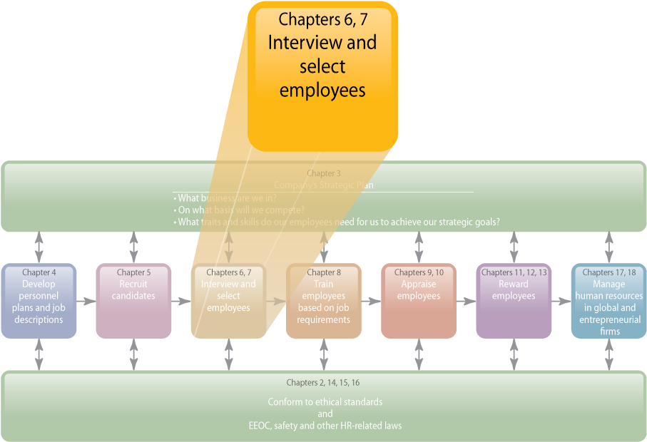
WHERE WE ARE NOW…
Notes:
Human Resources Management 12e
Gary Dessler
Copyright © 2011 Pearson Education, Inc. publishing as Prentice Hall
7–<number>
The main topics in this chapter include types of interviews, things that undermine interviewing’s usefulness, and designing and conducting effective selection interviews. If the interview is only one of several selection tools, why devote a whole chapter to this one tool? One answer is that interviews are the most widely used selection procedure.
It would be highly unusual for you not to interview someone before hiring that person. Most interviewers have little or no formal interview training, though they are confident [erroneously] that they can identify the best candidates regardless of the interview structure employed.

Slide 3
LEARNING OUTCOMES
List the main types of selection interviews.
List and explain main errors that can undermine an interview’s usefulness.
Define a structured situational interview.
Explain and illustrate each guideline for being a more effective interviewer.
Notes:
Human Resources Management 12e
Gary Dessler
Copyright © 2011 Pearson Education, Inc. publishing as Prentice Hall
7–<number>

Slide 4
Basic Types of Interviews
Selection Interview
Types of
Interviews
Appraisal Interview
Exit Interview
Notes:
Human Resources Management 12e
Gary Dessler
Copyright © 2011 Pearson Education, Inc. publishing as Prentice Hall
7–<number>
Managers use several interviews at work. For example, an appraisal interview is a discussion, following a performance appraisal, in which supervisor and employee discuss the employee’s ratings and possible remedial actions. When an employee leaves a firm, one often conducts an exit interview. This aims at eliciting information that might provide some insight into what’s right or wrong about the firm. Many techniques in this chapter apply to appraisal and exit interviews. However, we’ll postpone a fuller discussion of these two interviews until Chapters 9 and 10 and focus here on selection interviews.

Slide 5
Basic Types of Interviews
Appraisal Interview
  a discussion, following a performance appraisal, in which supervisor and employee discuss the employee’s ratings and possible remedial actions.
Exit Interview
  When an employee leaves a firm, one often conducts an exit interview.
  This aims at eliciting information that might provide some insight into what’s right or wrong about the firm.
Notes:
Human Resources Management 12e
Gary Dessler
Copyright © 2011 Pearson Education, Inc. publishing as Prentice Hall
7–<number>
In creating structured situational interviews, people familiar with the job develop questions based on the job’s actual duties. They then reach consensus on what are and are not acceptable answers. The procedure is as outline in this slide.

Slide 6
Selection Interview Structure
Selection Interview Characteristics
Interview
structure
Interview
content
Interview administration
Notes:
Human Resources Management 12e
Gary Dessler
Copyright © 2011 Pearson Education, Inc. publishing as Prentice Hall
7–<number>
We can classify selection interviews according to:
1. How structured they are
2. Their “content”—the types of questions they contain
3. How the firm administers the interviews

Slide 7
Selection Interview Formats
Interview Structure Formats
Unstructured (nondirective) interview
Structured
(directive)
interview
Notes:
Human Resources Management 12e
Gary Dessler
Copyright © 2011 Pearson Education, Inc. publishing as Prentice Hall
7–<number>
In unstructured (or nondirective) interviews, the manager follows no set format. A few questions might be specified in advance. Most selection interviews fall in this category.
In structured (or directive) interviews, the employer lists job-oriented questions ahead of time, and possible predetermined answers for appropriateness and scoring.

Slide 8
Selection Interview Formats
Unstructured (or nondirective) interview
  the manager follows no set format.
  A few questions might be specified in advance. Most selection interviews fall in this category.
Structured (or directive) interview
  the employer lists job-oriented questions ahead of time, and possible predetermined answers for appropriateness and scoring.
Notes:
Human Resources Management 12e
Gary Dessler
Copyright © 2011 Pearson Education, Inc. publishing as Prentice Hall
7–<number>
In creating structured situational interviews, people familiar with the job develop questions based on the job’s actual duties. They then reach consensus on what are and are not acceptable answers. The procedure is as outline in this slide.

Slide 9

Selection Interview Formats

Slide 10
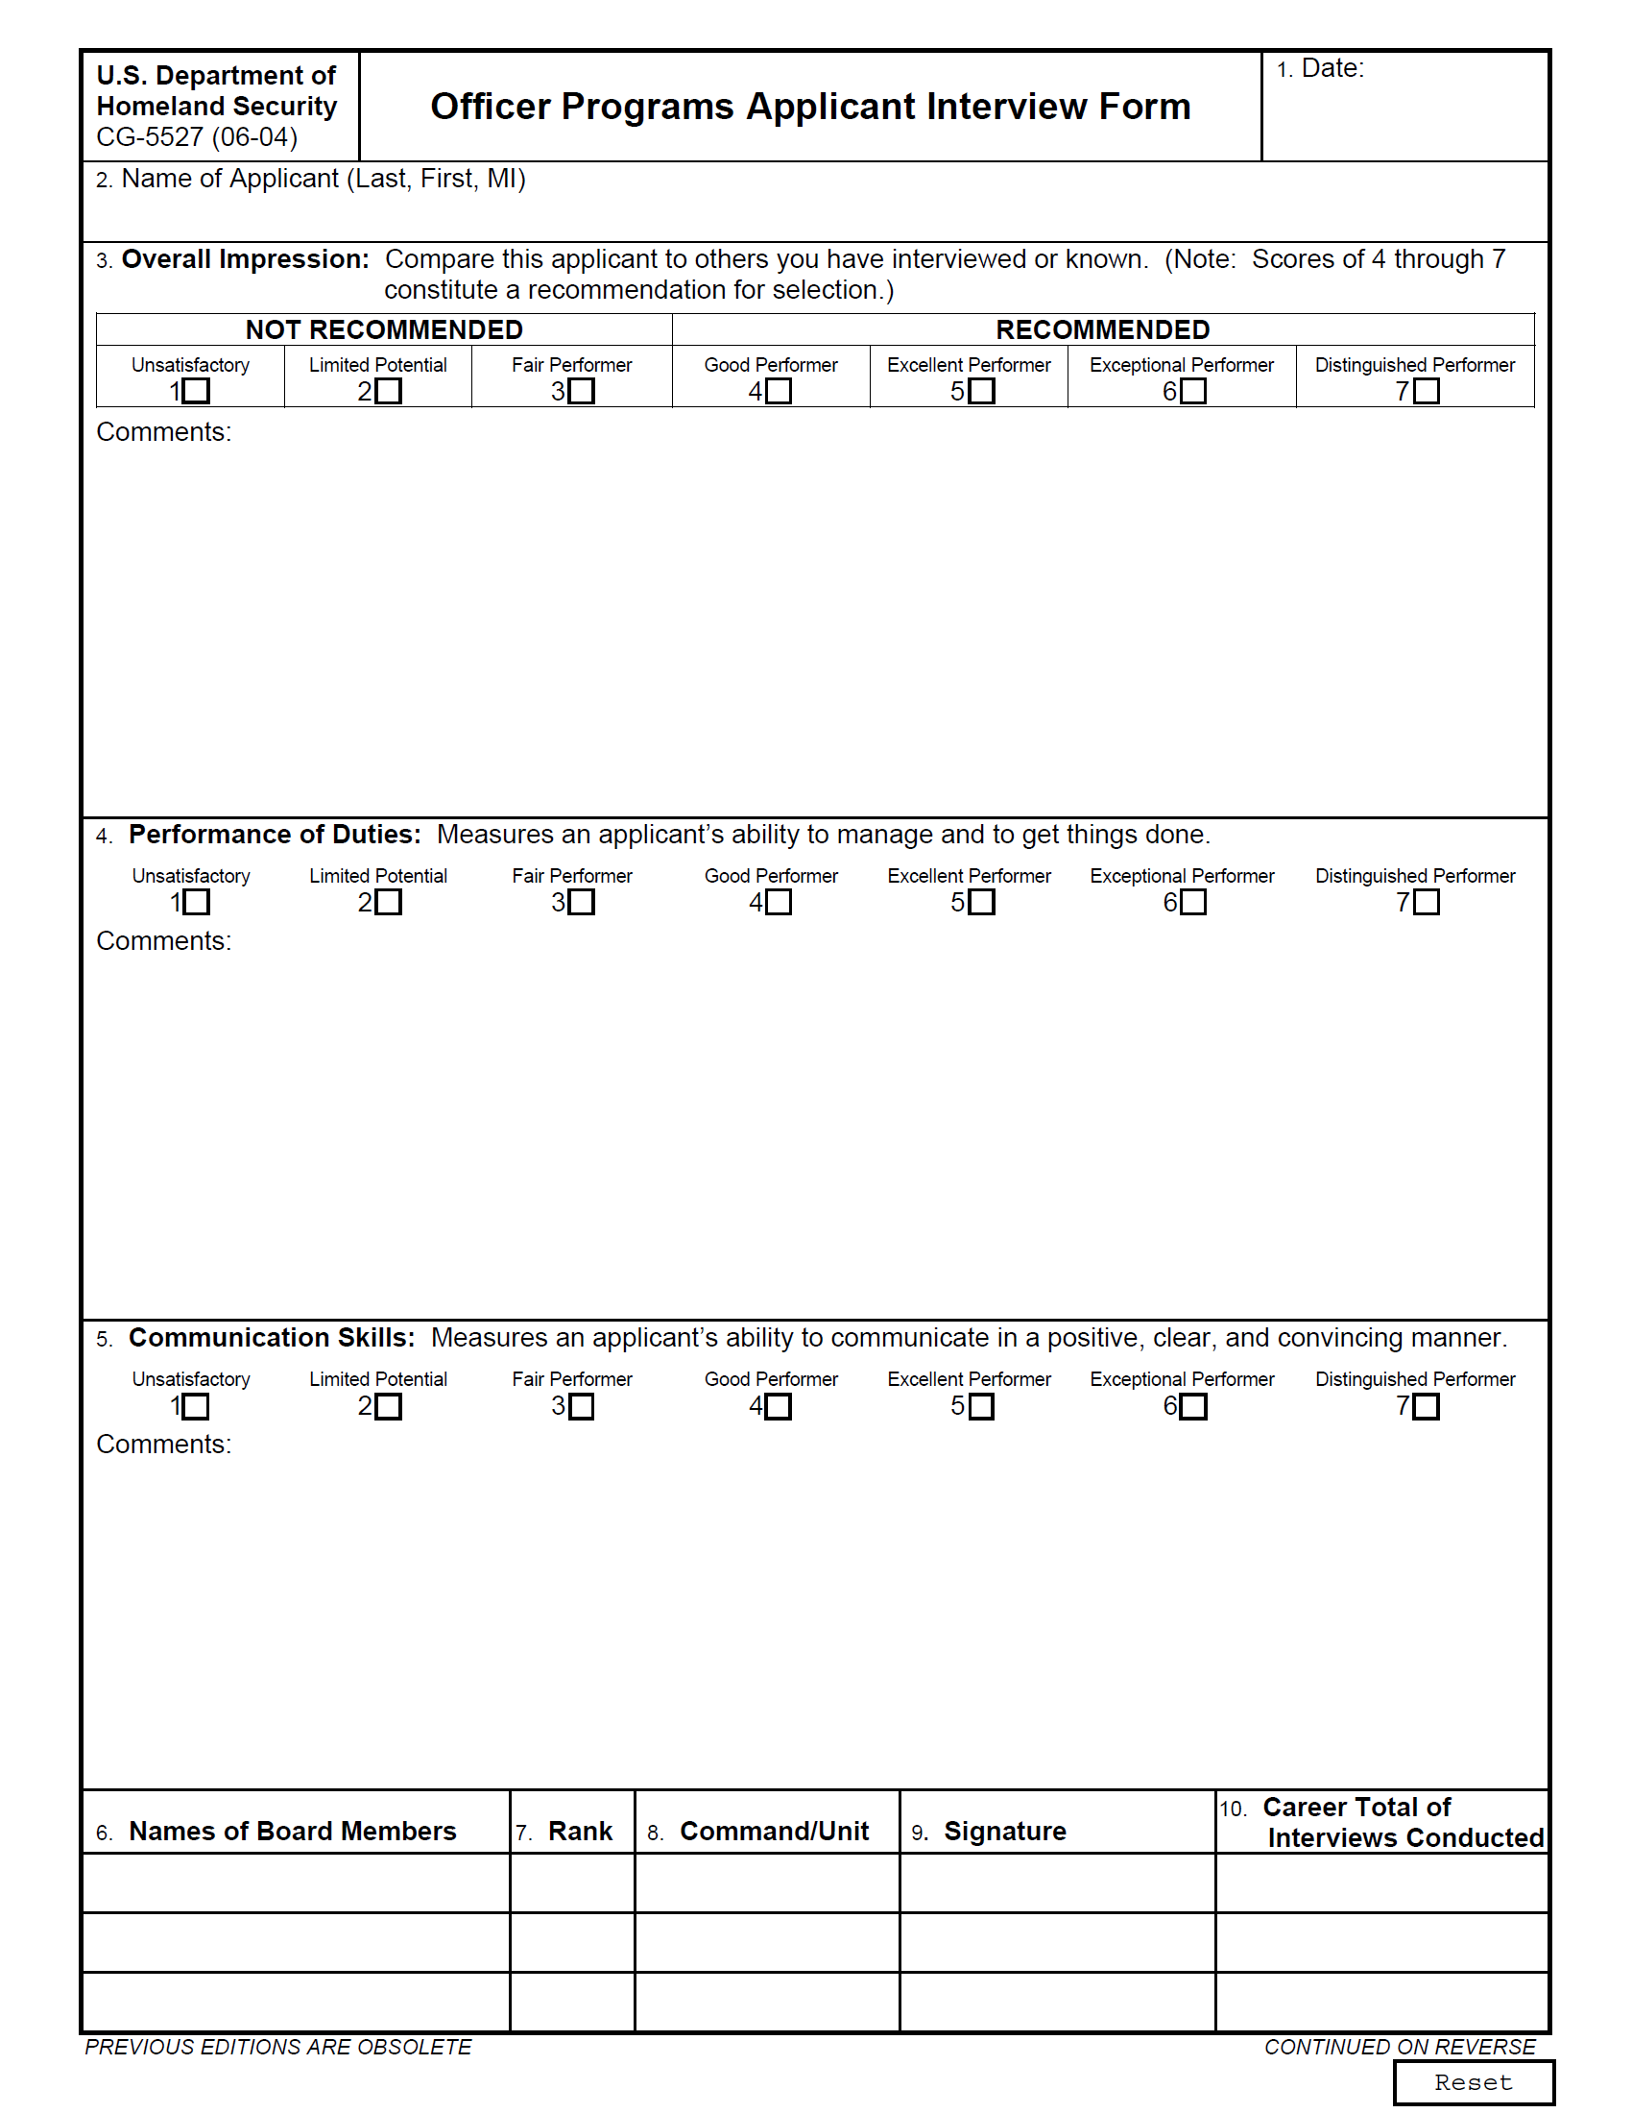
FIGURE 7–1 Officer Programs Applicant Interview Form
Notes:
Human Resources Management 12e
Gary Dessler
Copyright © 2011 Pearson Education, Inc. publishing as Prentice Hall
7–<number>
The Department of Homeland Security uses the structured guide in Figure 7-1 to help screen Coast Guard officer candidates. It contains a formal candidate rating procedure; it also enables geographically disbursed interviewers to complete the form over the Web.

Slide 11
FIGURE 7–1 Officer Programs Applicant Interview Form
Notes:
Human Resources Management 12e
Gary Dessler
Copyright © 2011 Pearson Education, Inc. publishing as Prentice Hall
7–<number>
The Department of Homeland Security uses the structured guide in Figure 7-1 to help screen Coast Guard officer candidates. It contains a formal candidate rating procedure; it also enables geographically disbursed interviewers to complete the form over the Web.

Slide 12
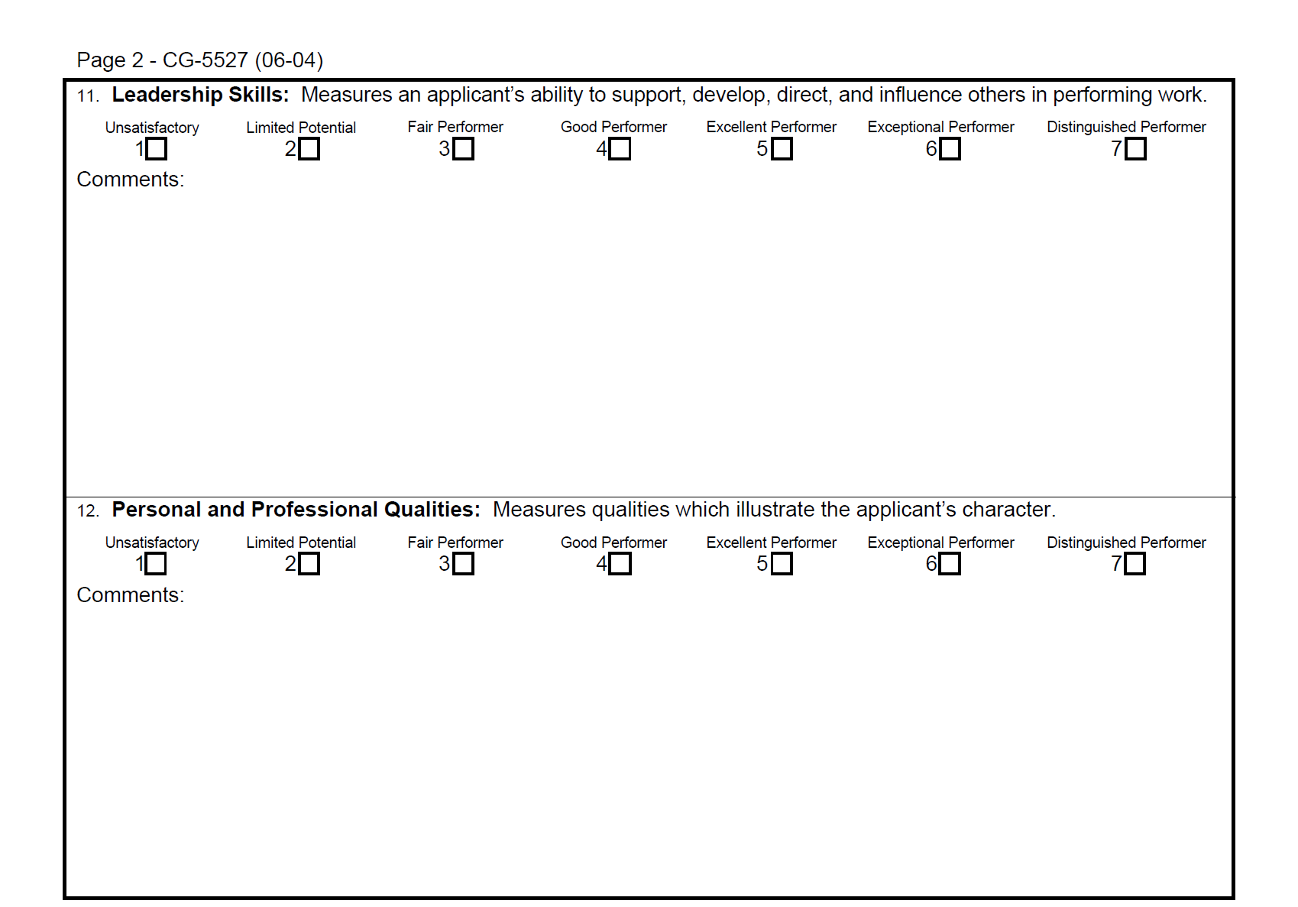
FIGURE 7–1 Officer Programs Applicant Interview Form
Notes:
Human Resources Management 12e
Gary Dessler
Copyright © 2011 Pearson Education, Inc. publishing as Prentice Hall
7–<number>
The Department of Homeland Security uses the structured guide in Figure 7-1 to help screen Coast Guard officer candidates. It contains a formal candidate rating procedure; it also enables geographically disbursed interviewers to complete the form over the Web.

Slide 13
Interview Content
Types of Questions Asked
Situational interview
Behavioral interview
Job-related interview
Stress
interview
Notes:
Human Resources Management 12e
Gary Dessler
Copyright © 2011 Pearson Education, Inc. publishing as Prentice Hall
7–<number>
We can also classify interviews based on the “content” or the types of questions asked in the interview. At work, situational, behavioral, and job-related questions are most important.

Slide 14
Interview Content
Situational interview
  A series of job-related questions that focus on how the candidate would behave in a given situation.
    Situational questions start with phrases such as “ Suppose you were faced with the following situation …What would you do?”
Behavioral interview
  A series of job-related questions that focus on how the candidate reacted to actual situations in the past.
    Behavioral questions might start with a phrase like, “Can you think of time when …What did you do?”
Notes:
Human Resources Management 12e
Gary Dessler
Copyright © 2011 Pearson Education, Inc. publishing as Prentice Hall
7–<number>
In creating structured situational interviews, people familiar with the job develop questions based on the job’s actual duties. They then reach consensus on what are and are not acceptable answers. The procedure is as outline in this slide.

Slide 15
Interview Content
Job-related interview
  A series of job-related questions that focus on relevant past job-related behaviors.
    Interviewer asks job related questions such as “ Which courses did you like best in business school?”
Stress interview
  An interview in which the applicant is made uncomfortable by a series of often rude questions .
  This technique helps identify hyper-sensitive applicants and those with low or high stress tolerance.
    Puzzle questions: Adis and Haris have 21KM between them. Adis has 20KM more than Haris. How much money has Adis and how much money has Haris?
Notes:
Human Resources Management 12e
Gary Dessler
Copyright © 2011 Pearson Education, Inc. publishing as Prentice Hall
7–<number>
In creating structured situational interviews, people familiar with the job develop questions based on the job’s actual duties. They then reach consensus on what are and are not acceptable answers. The procedure is as outline in this slide.

Slide 16
Administering the Interview
Unstructured sequential interview
Structured sequential interview
Panel
interview
Ways in Which Interview Can be Conducted
Mass
interview
Phone
interviews
Computerized interviews
Video/Web-assisted interviews
Notes:
Human Resources Management 12e
Gary Dessler
Copyright © 2011 Pearson Education, Inc. publishing as Prentice Hall
7–<number>
Employers also administer interviews in various ways: one-on-one or by a panel of interviewers; sequentially or all at once; and computerized or personally.

Slide 17
Administrating the Interview
Unstructured sequential interview
  An interview in which each interviewer forms an independent opinion after asking different questions.
Structured sequential interview
  An interview in which the applicant is interviewed sequentially by several persons; each rates the applicant on a standard form.
Panel(board) interview
  An interview conducted by a team of interviewers who together interview each candidate, and then combine their ratings into a final panel score.
Notes:
Human Resources Management 12e
Gary Dessler
Copyright © 2011 Pearson Education, Inc. publishing as Prentice Hall
7–<number>
In creating structured situational interviews, people familiar with the job develop questions based on the job’s actual duties. They then reach consensus on what are and are not acceptable answers. The procedure is as outline in this slide.

Slide 18
Administrating the Interview
Mass interview
  A panel interviews several candidates simultaneously.
Phone and video interview
  Some interviews are done entirely by telephone and videoconference.
Computerized interview
  One in which a job candidate’s oral and/or computerized replies are obtained in response to computerized oral, visual, or written questions and/or situations.
    How would your supervisor rate your customer service skills?
    a. outstanding c. average e. poor
    b. above average d. below average
Notes:
Human Resources Management 12e
Gary Dessler
Copyright © 2011 Pearson Education, Inc. publishing as Prentice Hall
7–<number>
In creating structured situational interviews, people familiar with the job develop questions based on the job’s actual duties. They then reach consensus on what are and are not acceptable answers. The procedure is as outline in this slide.

Slide 19
Administrating the Interview
Web-assisted interview
  Many firms use the Web to assist in the employee interview process.
Notes:
Human Resources Management 12e
Gary Dessler
Copyright © 2011 Pearson Education, Inc. publishing as Prentice Hall
7–<number>
In creating structured situational interviews, people familiar with the job develop questions based on the job’s actual duties. They then reach consensus on what are and are not acceptable answers. The procedure is as outline in this slide.

Slide 20
Three Ways to Make the Interview Useful
Structure the interview to increase its validity
Making the Interview Useful
Carefully choose what sorts of traits are to be assessed
Beware of committing interviewing errors
Notes:
Human Resources Management 12e
Gary Dessler
Copyright © 2011 Pearson Education, Inc. publishing as Prentice Hall
7–<number>
The interview holds an ironic place in the hiring process: If done poorly, it’s generally not too useful. If done properly, then the interview can be a much better predictor of performance than previously thought and is comparable with many other selection techniques.

Slide 21
What Can Undermine An Interview’s Usefulness?
First impressions (snap judgments)
Nonverbal behavior and impression management
Factors Affecting An Interview’s Usefulness
Interviewer’s
misunderstanding
of the job
Applicant’s personal characteristics
Candidate-order (contrast) error and pressure to hire
Interviewer’s inadvertent behavior
Notes:
Human Resources Management 12e
Gary Dessler
Copyright © 2011 Pearson Education, Inc. publishing as Prentice Hall
7–<number>
This slide summarizes potential interviewing errors to avoid:
• First impressions (snap judgments)
• Not clarifying what the job involves and requires
• Candidate-order error and pressure to hire
• Nonverbal behavior and impression management
• The effects of interviewees’ personal characteristics
• The interviewer’s inadvertent behavior

Slide 22
How to Design and Conduct
An Effective Interview
The Structured Situational Interview
  Use either situational questions or behavioral questions that yield high criteria-related validities.
    Step 1: Analyze the job.
    Step 2: Rate the job’s main duties.
    Step 3: Create interview questions.
    Step 4: Create benchmark answers.
    Step 5: Appoint the interview panel and conduct interviews.
Notes:
Human Resources Management 12e
Gary Dessler
Copyright © 2011 Pearson Education, Inc. publishing as Prentice Hall
7–<number>
In creating structured situational interviews, people familiar with the job develop questions based on the job’s actual duties. They then reach consensus on what are and are not acceptable answers. The procedure is as outline in this slide.

Slide 23
How to Conduct a More Effective Interview
Being Systematic and Effective
1
Know the job.
2
Structure the interview.
3
Get organized.
4
Establish rapport.
5
Ask questions.
6
Take brief, unobtrusive notes.
7
Close the interview.
8
Review the interview.
Notes:
Human Resources Management 12e
Gary Dessler
Copyright © 2011 Pearson Education, Inc. publishing as Prentice Hall
7–<number>
You may not have the time or inclination to create a full-blown, structured situational interview. However, there is still a lot you can do to make your interviews more systematic and effective.

Slide 24
Creating Effective Interview Structures
Base questions on actual job duties.
Use job knowledge, situational or behavioral questions, and objective criteria to evaluate interviewee’s responses.
Use the same questions with all candidates.
Use descriptive rating scales (excellent, fair, poor) to rate answers.
If possible, use a standardized interview form.
Notes:
Human Resources Management 12e
Gary Dessler
Copyright © 2011 Pearson Education, Inc. publishing as Prentice Hall
7–<number>
Any structuring is usually better than none. If pressed for time, you can do several things to ask more consistent and job-relevant questions, without developing a full-blown structured interview.

Slide 25
FIGURE 7–2 Examples of Questions That Provide Structure
Situational Questions
1. Suppose a more experienced coworker was not following standard work procedures and claimed the new procedure was better. Would you use the new procedure?
2. Suppose you were giving a sales presentation and a difficult technical question arose that you could not answer. What would you do?
Past Behavior Questions
3. Based on your past work experience, what is the most significant action you have ever taken to help out a coworker?
4. Can you provide an example of a specific instance where you developed a sales presentation that was highly effective?
Background Questions
5. What work experiences, training, or other qualifications do you have for working in a teamwork environment?
6. What experience have you had with direct point-of-purchase sales?
Job Knowledge Questions
7. What steps would you follow to conduct a brainstorming session with a group of employees on safety?
8. What factors should you consider when developing a television advertising campaign?
Notes:
Human Resources Management 12e
Gary Dessler
Copyright © 2011 Pearson Education, Inc. publishing as Prentice Hall
7–<number>
Figure 7-2 illustrates several examples of structured job knowledge, situational, background or behavioral interview questions.

Slide 26
FIGURE 7–3 Suggested Supplementary Questions for Interviewing Applicants
How did you choose this line of work?
What did you enjoy most about your last job?
What did you like least about your last job?
What has been your greatest frustration or disappointment on your present job? Why?
What are some of the pluses and minuses of your last job?
What were the circumstances surrounding your leaving your last job?
Did you give notice?
Why should we be hiring you?
What do you expect from this employer?
What are three things you will not do in your next job?
What would your last supervisor say your three weaknesses are?
What are your major strengths?
How can your supervisor best help you obtain your goals?
How did your supervisor rate your job performance?
In what ways would you change your last supervisor?
What are your career goals during the next 1–3 years? 5–10 years?
How will working for this company help you reach those goals?
What did you do the last time you received instructions with which you disagreed?
What are some things about which you and your supervisor disagreed? What did you do?
Which do you prefer, working alone or working with groups?
What motivated you to do better at your last job?
Do you consider your progress in that job representative of your ability? Why?
Do you have any questions about the duties of the job for which you have applied?
Can you perform the essential functions of the job for which you have applied?
Notes:
Human Resources Management 12e
Gary Dessler
Copyright © 2011 Pearson Education, Inc. publishing as Prentice Hall
7–<number>
Figure 7-3 contains a sampling of technical questions to be asked in interviews.

Slide 27
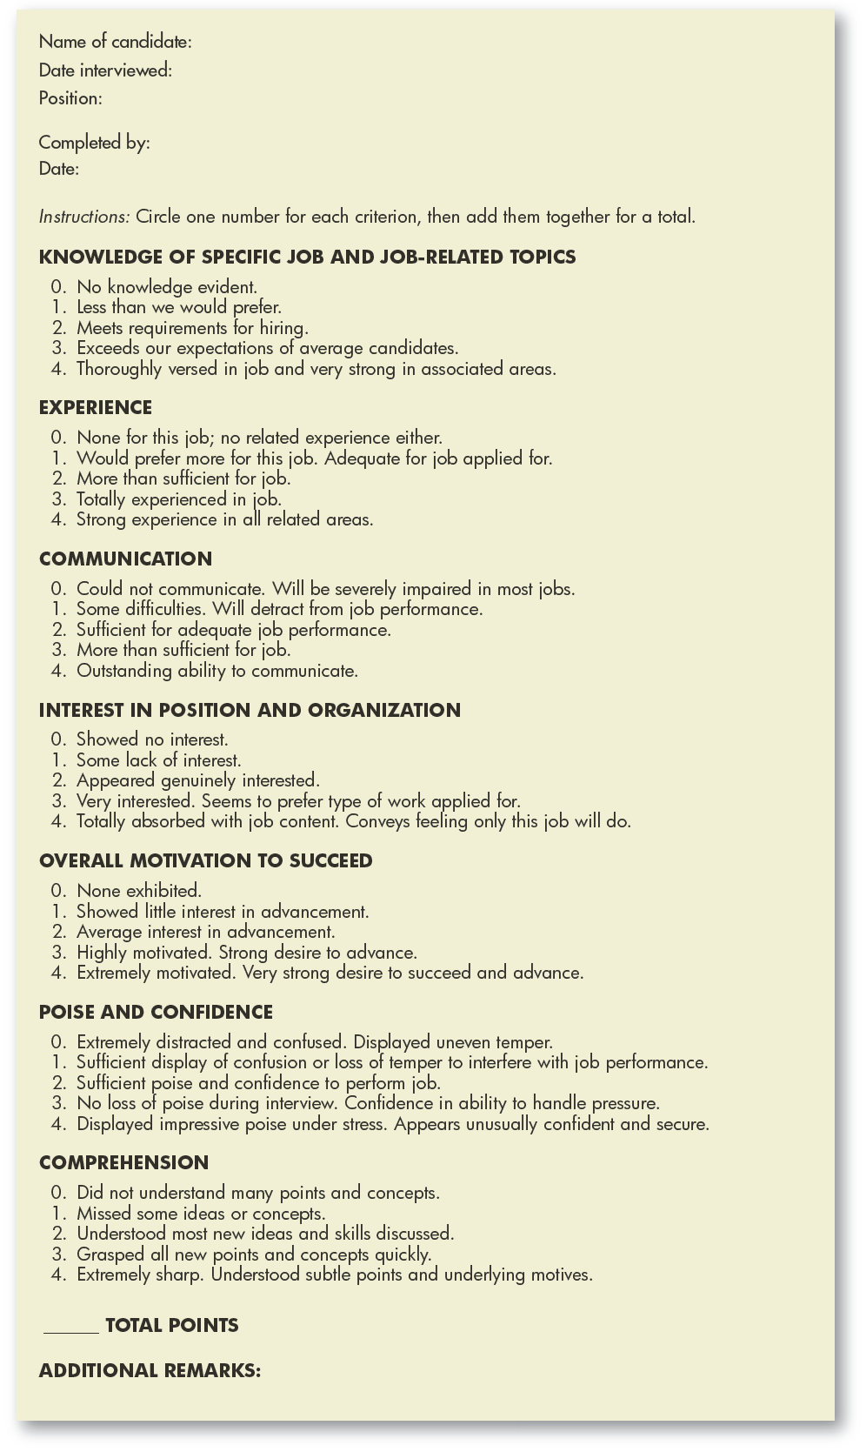
FIGURE 7–4
Interview Evaluation
Form
Notes:
Human Resources Management 12e
Gary Dessler
Copyright © 2011 Pearson Education, Inc. publishing as Prentice Hall
7–<number>
A manager can use an interview evaluation form such as the one in Figure 7-4 to compile his or her impressions of an applicant.

Slide 28
FIGURE 7–4
Interview Evaluation
Form
Notes:
Human Resources Management 12e
Gary Dessler
Copyright © 2011 Pearson Education, Inc. publishing as Prentice Hall
7–<number>
A manager can use an interview evaluation form such as the one in Figure 7-4 to compile his or her impressions of an applicant.

Slide 29
Guidelines for Interviewees
Preparation is essential.
Uncover the interviewer’s real needs.
Relate yourself to the interviewer’s needs.
Think before answering.
Remember that appearance and enthusiasm are important.
Make a good first impression.
Ask questions.
Notes:
Human Resources Management 12e
Gary Dessler
Copyright © 2011 Pearson Education, Inc. publishing as Prentice Hall
7–<number>
Before you get into a position where you have to interview others, you will probably have to navigate some interviews yourself. It’s therefore useful to apply these guidelines to navigating your own interviews.

Slide 30
K E Y T E R M S
unstructured (or nondirective) interview
structured (or directive) interview
situational interview
behavioral interview
job-related interview
stress interview
unstructured sequential interview
structured sequential interview
panel interview
mass interview
candidate-order error (or contrast) error
structured situational interview
Notes:
Human Resources Management 12e
Gary Dessler
Copyright © 2011 Pearson Education, Inc. publishing as Prentice Hall
7–<number>

